Slide 1
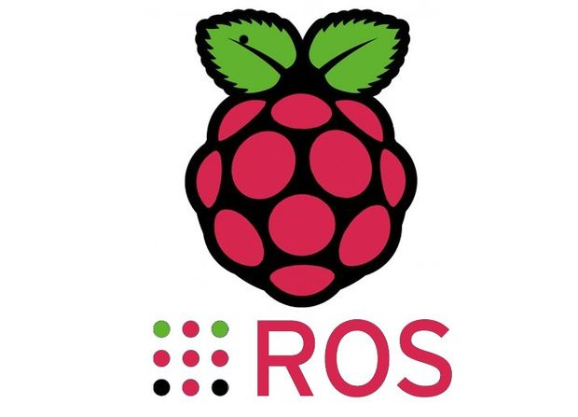

ROS Workshop
-Lecture 1-
Python - Raspberry Pi - Robot Operating System
Husnu Melih Erdogan
Lab Assistant
Intelligent Robotics Lab

Slide 2
Grading Options
Option 1 : ROS Lectures %30 (1-2 Hours per week) + Short ROS Assignments
Option 2 : Lab Hours %15 (2 Hours per week) + Lab Reports %15 (one page)

Slide 3

Course Structure
Lecture 4 - (Spring - Week 4)
ROS Services and Messages
Writing a Service and Client
ROS .bag file
Lab Assignment 4
Lecture 5 - (Spring - Week 5)
URDF
TF
RVIZ
Getting started with Turtlebot
Lab Assignment 5
Lecture 6 - (Spring - Week 6)
MoveIt
Creating Vikingbot URDF
Robot_State_Publisher
Joint_State_Publisher
Lab Assignment 6
Lecture 7 - (Spring - Week 7)
Gazebo
Creating a Simple Vikingbot Simulation
Lab Assignment 7
Spring Week 8 - 9 - 10
Turtlebot - Vikingbot Project
Lecture 1 – (Spring - Week 1)
What is ROS?
Introduction to ROS
ROS architecture, philosophy, history
How to install ROS?
Python basics
Examples
Lab Assignment 1
Lecture 2 – (Spring - Week2 )
Linux Basics
XML Format
ROS commands
Getting familiar with the ROS filesystem
How to create a ROS package?
How to build a ROS package?
How to install released ROS packages?
How to build packages from source?
Lab Assignment 2
Lecture 3 - (Spring - Week 3)
ROS Nodes Detail
ROS Topics Detail
Writing a Publisher and Subscriber
Lab Assignment 3

Slide 4
What is ROS?
ROS stands for Robot Operating System.
However it is not a real operating system such a Linux, Windows, IOSX
It is framework.
It is more like a middleware that sits between your operating system and your program in C++, Python, and Matlab etc.

Slide 5
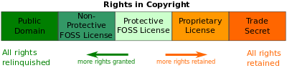
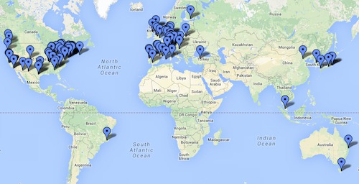
Why ROS is useful?
A distributed, modular design
A very large community
Permissive Licensing
"lets people do anything they want with your code as long as they provide attribution back to you and don’t hold you liable."
Collaborative Environment
It is free.
Supports different programming languages
Matlap, C++, Python, Lisp
A very important technical skill to have in your resume.

Slide 6
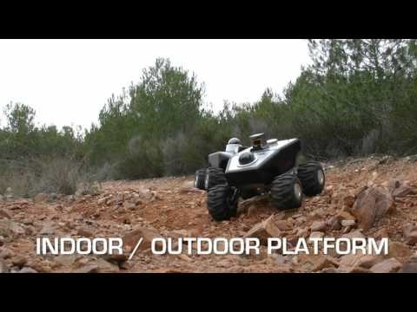
History of ROS
It is developed in 2007 at the Stanford Artificial Intelligence Lab.
It was managed by Willow Garage.
Open Source Robotics Foundations has been managing it since 2013.

Slide 7
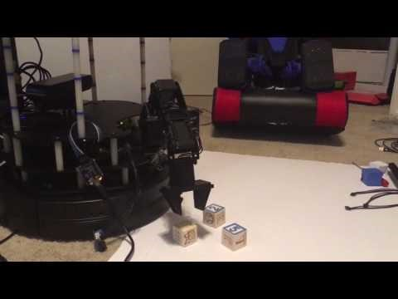
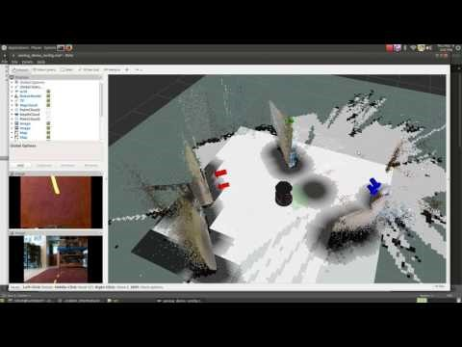
Turtlebot

Slide 8
ROS Philosophy
Peer to Peer
Individual programs communicate over defined API (ROS messages, services)
Distributed
Programs can be run on multiple computers and communicate over the network.
Supports Multiple Languages
ROS modules can be written in any language for which a client library exist (C++, Python, MATLAB, Java, etc.)
Light-weight
Stand-alone libraries are wrapped around with in a thin ROS layer.
It doesn’t mean ROS doesn’t use your CPU or don’t need a powerful PC.
Some packages could use all almost your system resources.
Free and Open-Source
It is totally free and supported by a considerably large community.
It is backed by many universities and industrial companies.
It becomes a standard in the robotics field.

Slide 9
How to Install ROS?
Installing ROS on PC – Ubuntu
Installing ROS on Virtual Machine
Installing ROS on Raspberry Pi 3 - Jessie
Installing ROS on Raspberry Pi – Ubuntu Mate

Slide 10
ROS Server
We have ROS installed server PC in our lab.
It runs Ubuntu 14.04
The version of ROS that is installed on the Server is Indigo
The IP Address: TBD
User Name: - Your First Name
Password: - ‘SpringROS12345’ - Do not forget to change your password

Slide 11
ROS Workspace Environment
Standard name for it catkin_ws
You can use whatever name you want.
Check your work space.
First you need to source your setup.*sh.
The setup.bash files setup your environment variables and paths.
source /opt/ros/<distro>/setup.bash
Ex: source /opt/ros/kinetic/setup.bash

Slide 12
Create a Catkin Workspace
What is catkin?
A catkin workspace is a folder where you modify, build, and install catkin packages. It is specified in REP 128. (wiki.ros.org)
Catkin packages can be built as a standalone project, in the same way that normal cmake projects can be built, but catkin also provides the concept of workspaces, where you can build multiple, interdependent packages together all at once.

Slide 13

Create a Catkin Workspace
- mkdir -p ~/catkin_ws/src
(create a new directory called src in another directory called catkin ws)
- cd ~/catkin_ws/src
( go into the src directory)
- catkin_init_workspace
(initialize the workspace)
cd ~/catkin_ws/
(go into your brand new workspace)
catkin_make
(build your code in a catkin workspace)
source devel/setup.bash
(Before continuing make sure you source your new setup.*sh file)
echo $ROS_PACKAGE_PATH
Test your path: /home/youruser/catkin_ws/src:/opt/ros/kinetic/share

Slide 14
ROS Master
In charge of managing the communication between nodes
Every node registers with the master when you run them
In order to start a master type:
roscore

Slide 15
Ros Nodes
Single-purpose, executable program written in Python, C++, Matlab etc
Individually complied, executed and managed.
You can run, stop, and kill nodes whenever you want.
They run in parallel.
In order to run a node type:
rosrun package_name node_name
See active nodes running on ROS
rosnode list
In order to get more information about nodes type:
rosnode info node_name

Slide 16

ROS Master and Nodes
ROS Master
Registration
Registration
Registration
Node 1
Node 2
Node 3

Slide 17
ROS Topics
ROS Nodes communicate over topics.
Each node can publish or subscribe topics
When one of the nodes register with the master, node also tells master that I am the publisher of these topics. Therefore, other nodes can know who publishes that topic and subtribe that topic.
List all active topics :
rostopic list
Subscribe and print the contents of a topic
rostopic echo /topic-name
Show information about the topic
rostopic info /topic-name
Show all the other possible rostopic commands
rostopic -h

Slide 18
Other ROS Topic Commands
rostopic bw display bandwidth used by topic
rostopic echo print messages to screen
rostopic hz display publishing rate of topic
rostopic list print information about active topics
rostopic pub publish data to topic
rostopic type print topic type

Slide 19
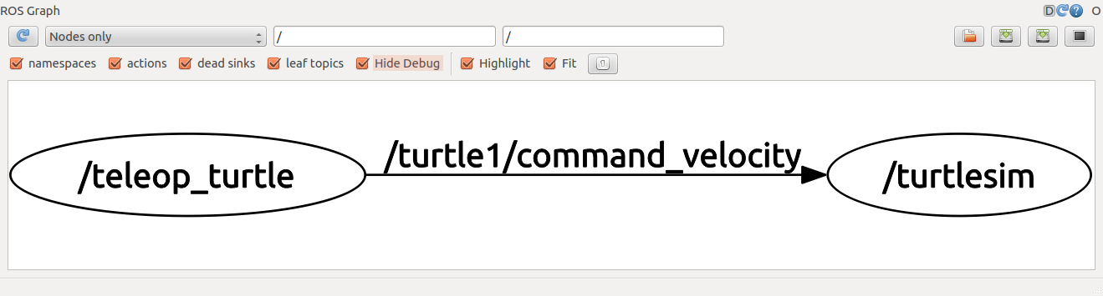

Using rqt-graph
rqt_graph tool is used to create a dynamic graph of what's going on in the system that includes all nodes and topics
To run rqt-graph
rosrun rqt_graph rqt_graph

Slide 20

ROS Master, Nodes, Topics
ROS Master
Registration
Registration
Registration
Node 1
Publisher
Node 2
Subscriber
Node 3
Subscriber and Publisher
Subscribe
Publish
Publish
Subscribe
Topic
Topic

Slide 21

ROS Messages
ROS message describes the data values that ROS nodes publish.
Messages help ROS tolls to automatically generate code for the message type in several target languages.
Message descriptions are in .msg files in the msg/ directory.
Messages can be nested in each other.
Each ROS distribution can have a different description for a message
You can go to http://wiki.ros.org/msg and check the message type
Publish a message to a subscriber ROS node on command line.
rostopic pub /mytopic std_msg/String “data: ‘Portland State University’”

Slide 22
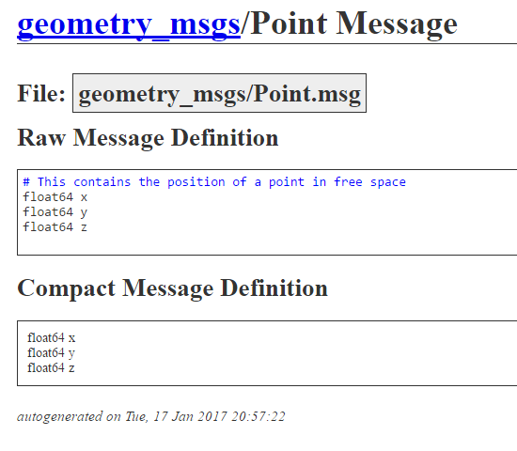
Example ROS Message Definition:

Slide 23
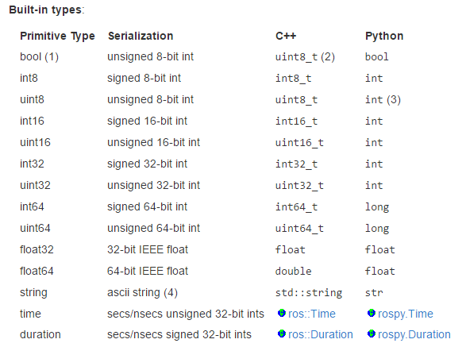

Message Types
You must not use the names of built-in types or Header when constructing your own message types.

Slide 24
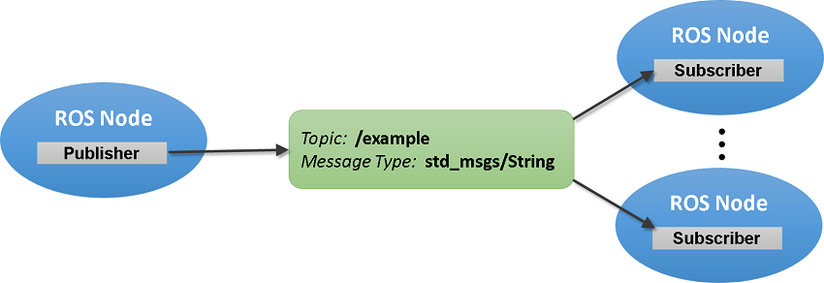
Summary of ROS Messages
Image Source Link

Slide 25

ROS Package
Software in ROS is organized in packages.
A package can contain your ROS nodes, any libraries, a dataset, configuration files, message types, scripts, service types, some third-party software.
When you want to create a project in ROS, first you need to create a package
You can also download and install many packages written by other ROS users around the world
You can submit the ROS package you write to the ROS package repository
Every ROS package is for certain ROS distributions
Packages have dependencies
http://www.ros.org/browse/list.php?package_type=package&distro=indigo

Slide 26

ROS Launch
Sometimes you have so many nodes with many different arguments and parameters to run in a project.
Roslaunch is a tool for easily launching multiple ROS nodes as well as setting parameters in the parameter server.
The basic idea is to list, in a specific XML format, a group of nodes that should be started at the same time.

Slide 27
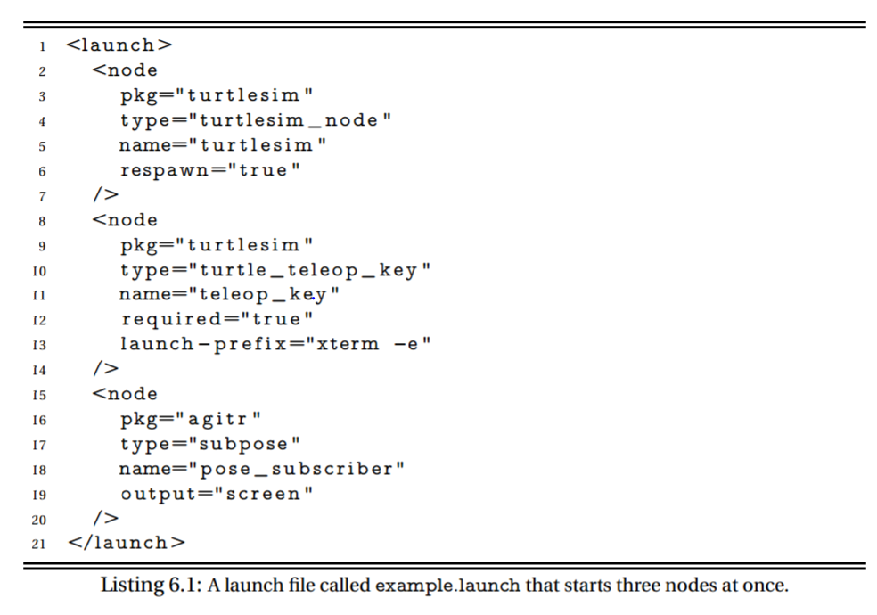
Example Launch File

Slide 28
Some useful ROS command-line tools
rospack: find and retrieve information about packages
catkin_create_pkg: create a new package
catkin_make: build a workspace of packages
rosdep: install system dependencies of a package
rqt: In rqt there is a plugin called "Introspection/Package Graph", which visualizes package dependencies as a graph

Slide 29
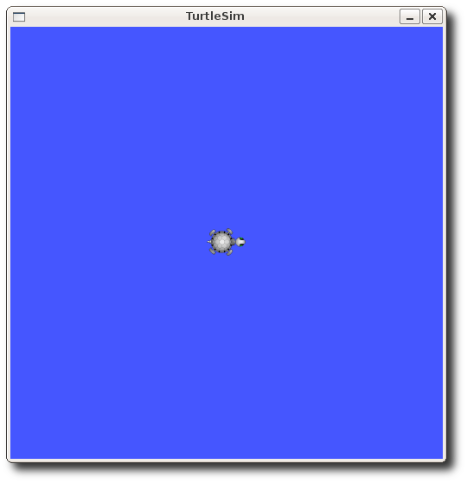

Turtlesim Example
http://wiki.ros.org/turtlesim

Slide 30
ROS Cheatsheet
https://github.com/ros/cheatsheet/releases/tag/0.0.1

Slide 31
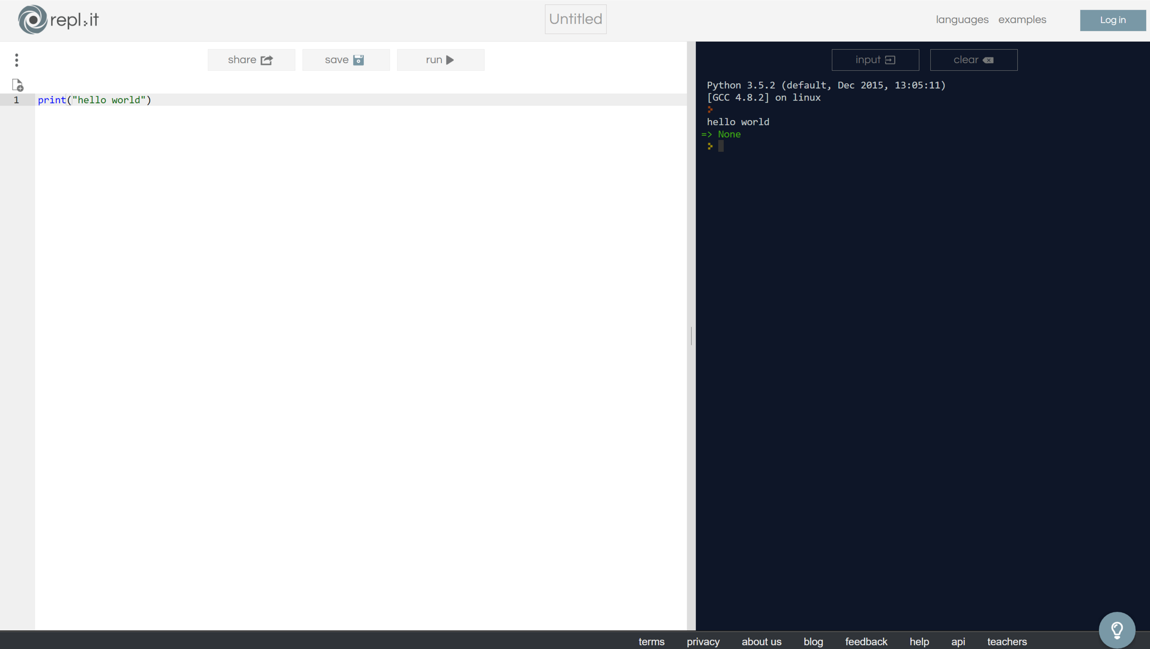

Python Compiler
https://repl.it/languages/python3

Slide 32
Python
You are free to whatever programming language you want to use with ROS.
You can use either Python or C++ to do the assignments.
I will use Python to teach ROS.
In order to understand how ROS works, it doesn’t really matter if you use Python or C++.
However, for better performance I recommend you to write your packages in C++.
If you want to build a prototype in a very short time, Python is a better choice.

Slide 33
Python Basics
Python is an easy to learn, powerful programming language. It has efficient high-level data structures and a simple but effective approach to object-oriented programming. Python’s elegant syntax and dynamic typing, together with its interpreted nature, make it an ideal language for scripting and rapid application development in many areas on most platforms.
https://www.python.org/
https://docs.python.org/3/tutorial/index.html
We will use Python 3.

Slide 34
Why Python is great?
Python is Interpreted: Python is processed at runtime by the interpreter. You do not need to compile your program before executing it. This is similar to PERL and PHP.
Python is Interactive: You can actually sit at a Python prompt and interact with the interpreter directly to write your programs.
Python is Object-Oriented: Python supports Object-Oriented style or technique of programming that encapsulates code within objects.
Python is a Beginner's Language: Python is a great language for the beginner-level programmers and supports the development of a wide range of applications from simple text processing to world wide web browsers to games.

Slide 35
Reserved Words
The following list shows the Python keywords. These are reserved words and you cannot use them as constant or variable or any other identifier names. All the Python keywords contain lowercase letters only.
and | exec | not
assert | finally | or
break | for | pass
class | from | print
continue | global | raise
def | if | return
del | import | try
elif | in | while
else | is | with
except | lambda | yield

Slide 36
Variable
There is no variable type in Python
# This is how you comment
name = “Marek Perkowski” # This is a string variable
print(name)
print “hello world”
number = 1903 # This is an integer variable
my_gpa = 3.99 # This is A floating point variable

Slide 37
Operators
+ Addition | Adds values on either side of the operator. | a + b = 30
- Subtraction | Subtracts right hand operand from left hand operand. | a – b = -10
* Multiplication | Multiplies values on either side of the operator | a * b = 200
/ Division | Divides left hand operand by right hand operand | b / a = 2
% Modulus | Divides left hand operand by right hand operand and returns remainder | b % a = 0
** Exponent | Performs exponential (power) calculation on operators | a**b =10 to the power 20
// | Floor Division - The division of operands where the result is the quotient in which the digits after the decimal point are removed. But if one of the operands is negative, the result is floored, i.e., rounded away from zero (towards negative infinity): | 9//2 = 4 and 9.0//2.0 = 4.0, -11//3 = -4, -11.0//3 = -4.0

Slide 38
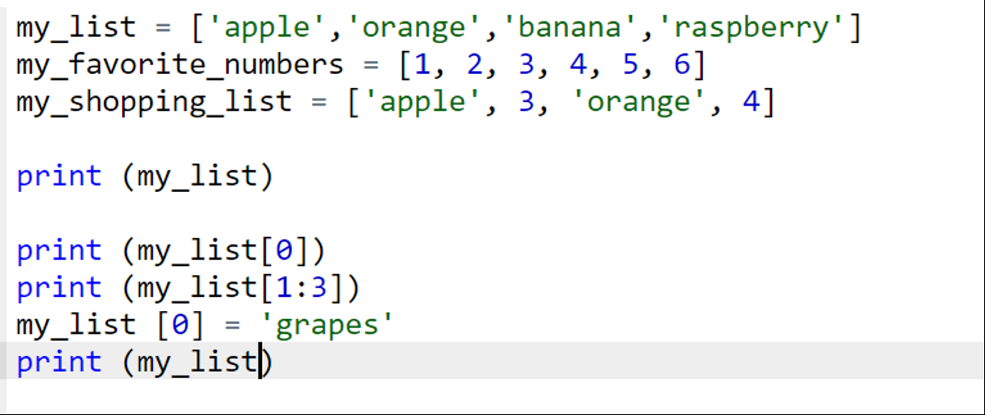
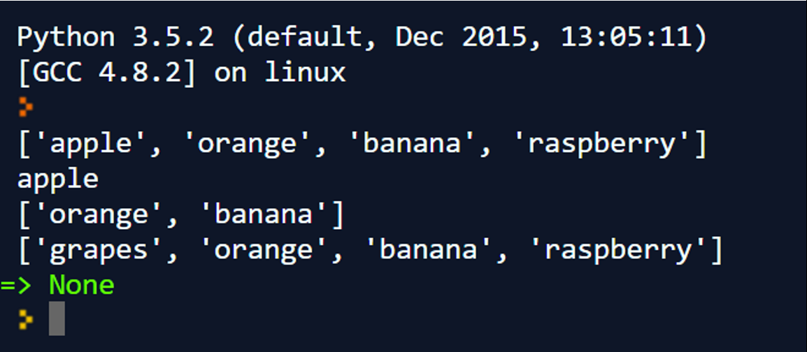
Lists
A list contains items separated by commas and enclosed within square brackets.

Slide 39
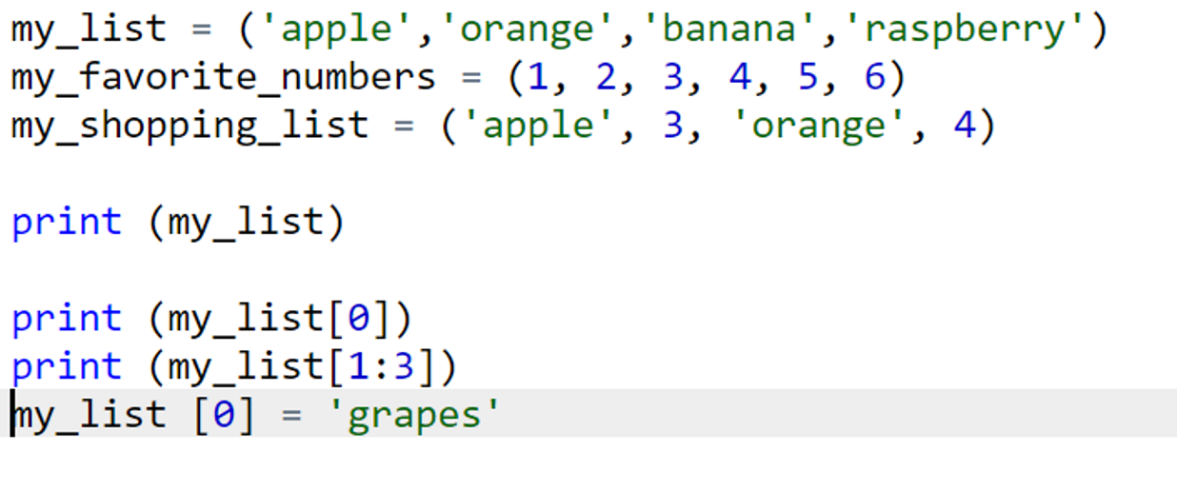
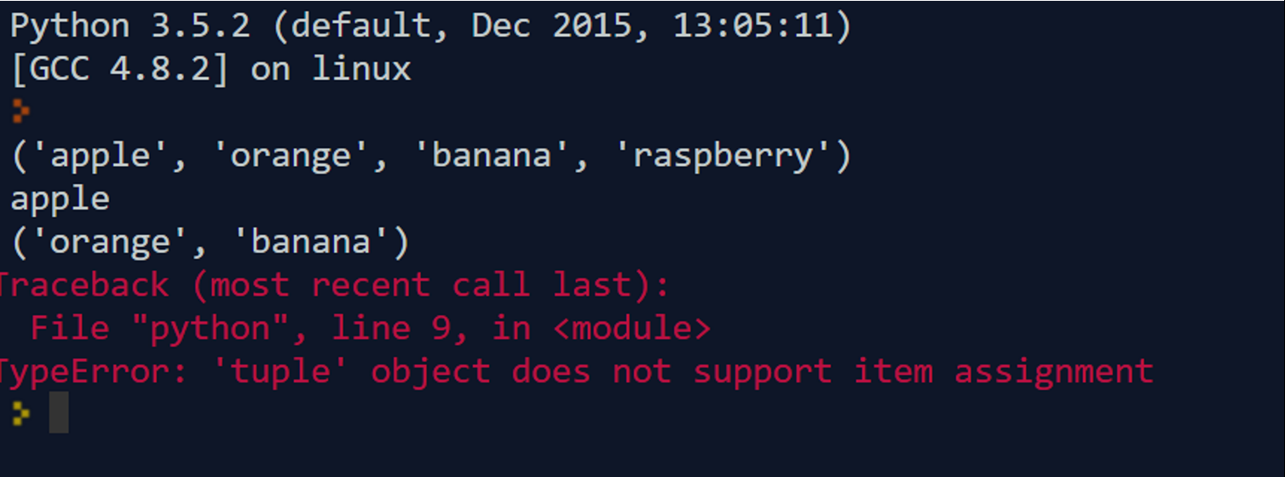
Tuples
A tuple is another sequence data type that is similar to the list. A tuple consists of a number of values separated by commas. Unlike lists, however, tuples are enclosed within parentheses.
It is only-read

Slide 40
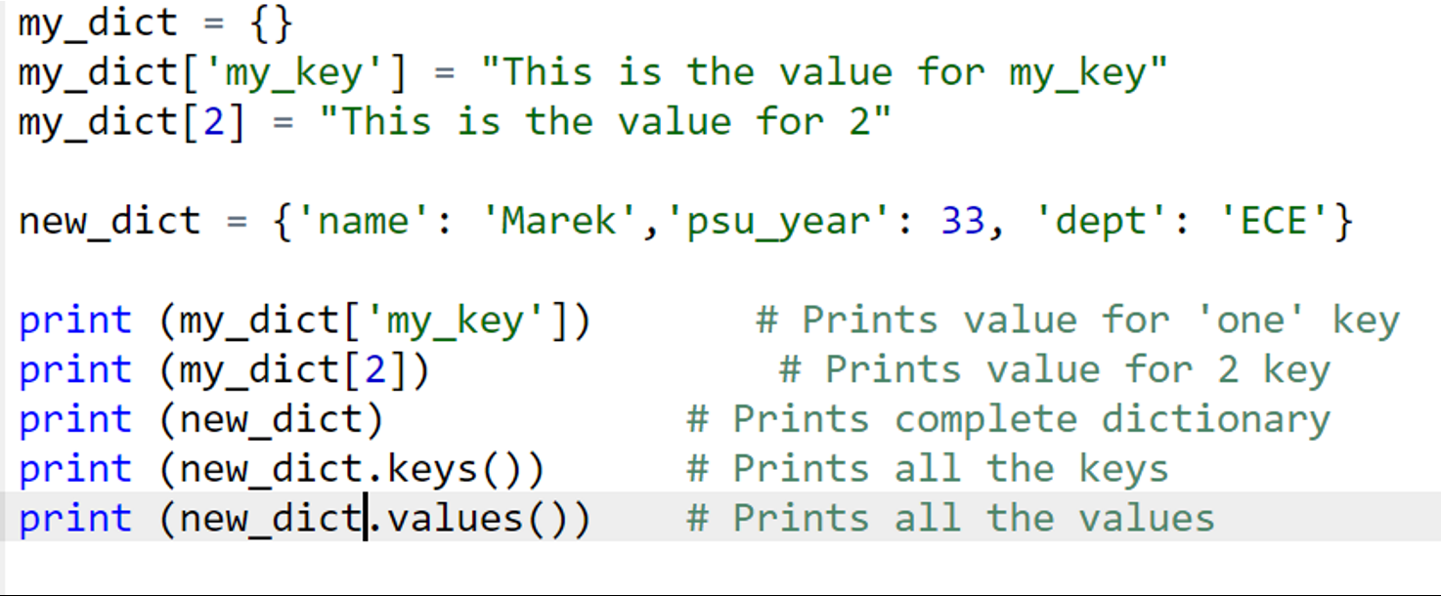
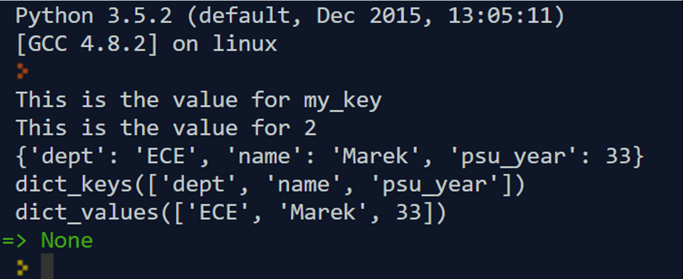
Dictionary
Python's dictionaries are kind of hash table type. They work like associative arrays or hashes found in Perl and consist of key-value pairs. A dictionary key can be almost any Python type, but are usually numbers or strings. Values, on the other hand, can be any arbitrary Python object.

Slide 41
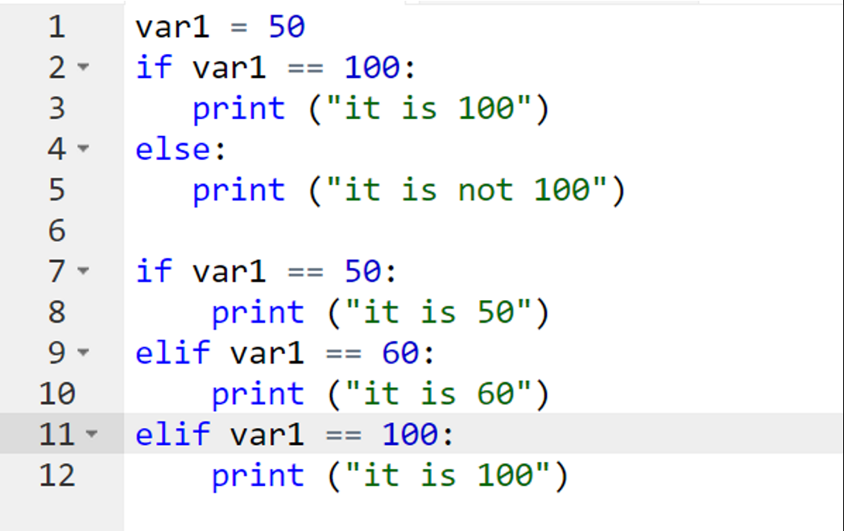
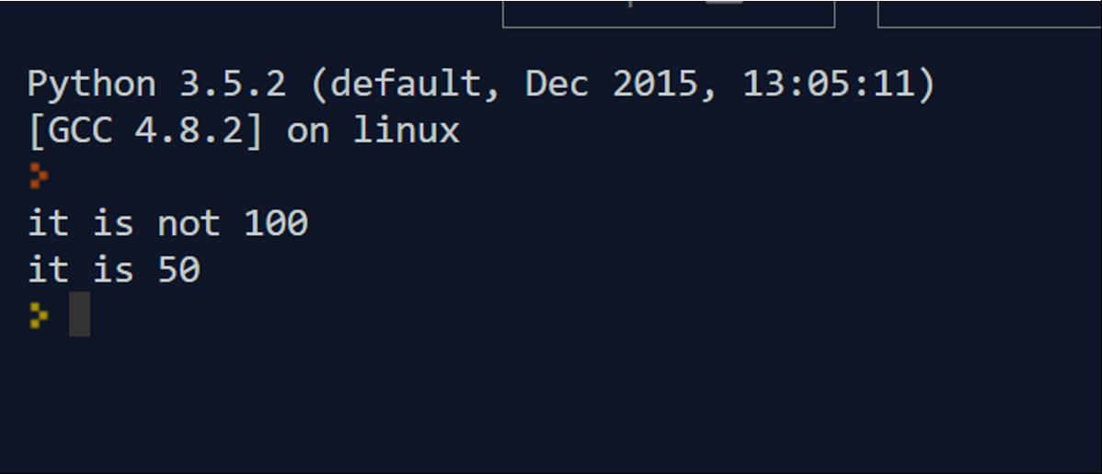
Conditional Statements – If, elif, else
The if statement contains a logical expression using which data is compared and a decision is made based on the result of the comparison.
An else statement can be combined with an if statement. An else statement contains the block of code that executes if the conditional expression in the if statement resolves to 0 or a FALSE value.
The elif statement allows you to check multiple expressions for TRUE and execute a block of code as soon as one of the conditions evaluates to TRUE.

Slide 42
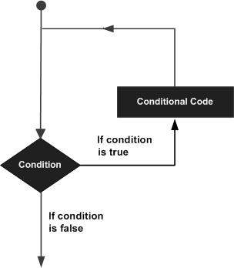
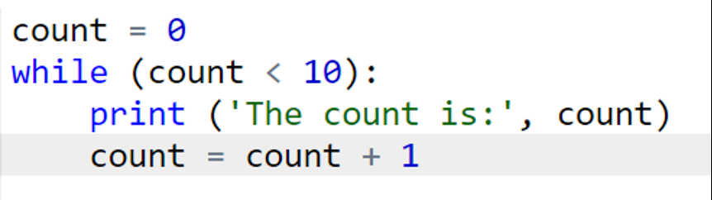
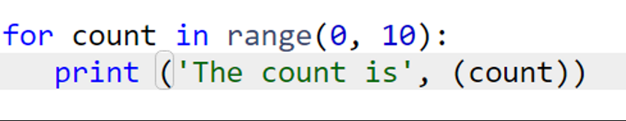
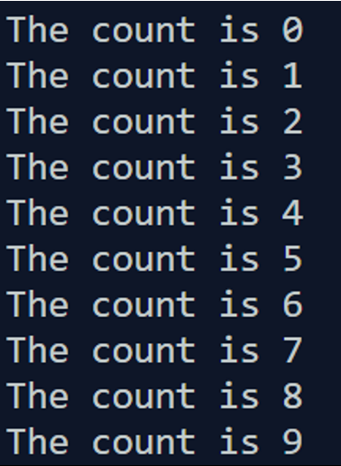
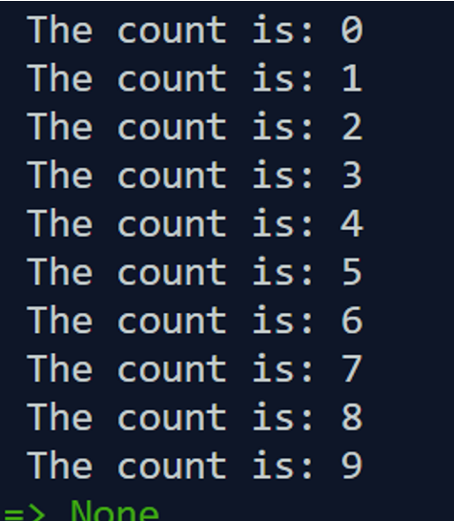
Loops – While, For
For Loop
While Loop

Slide 43
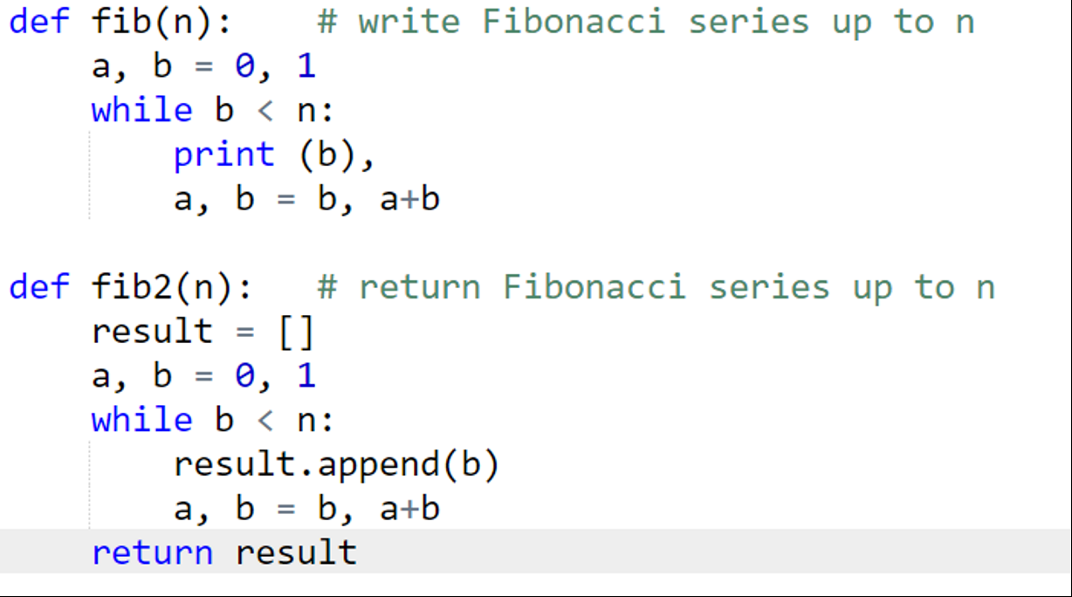
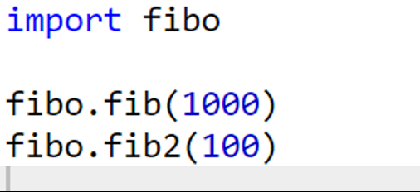
Using Modules
main.py
fibo.py

Slide 44
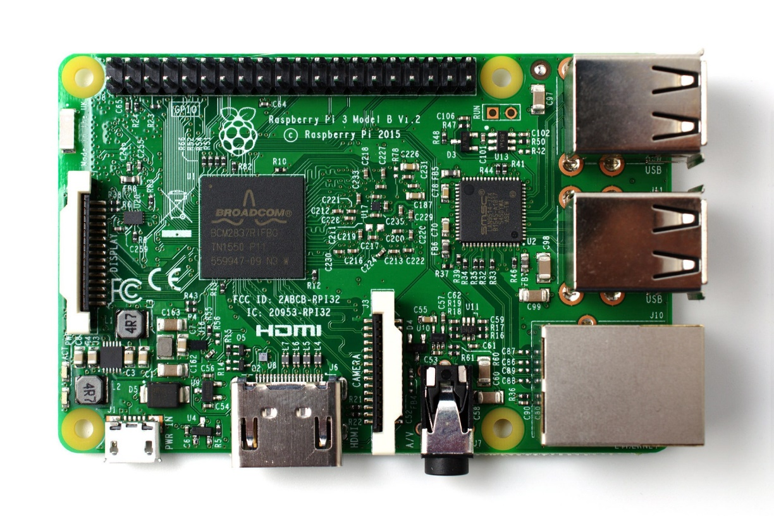
What is Raspberry Pi?
The Raspberry Pi is a credit card-sized computer that plugs into your TV and a keyboard. It is a capable little computer which can be used in electronics projects, and for many of the things that your desktop PC does, like spreadsheets, word processing, browsing the internet, and playing games. It also plays high-definition video. (www.raspberrypi.org)

Slide 45
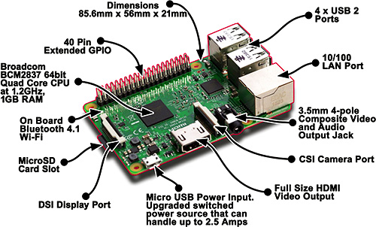
What is on the board?

Slide 46
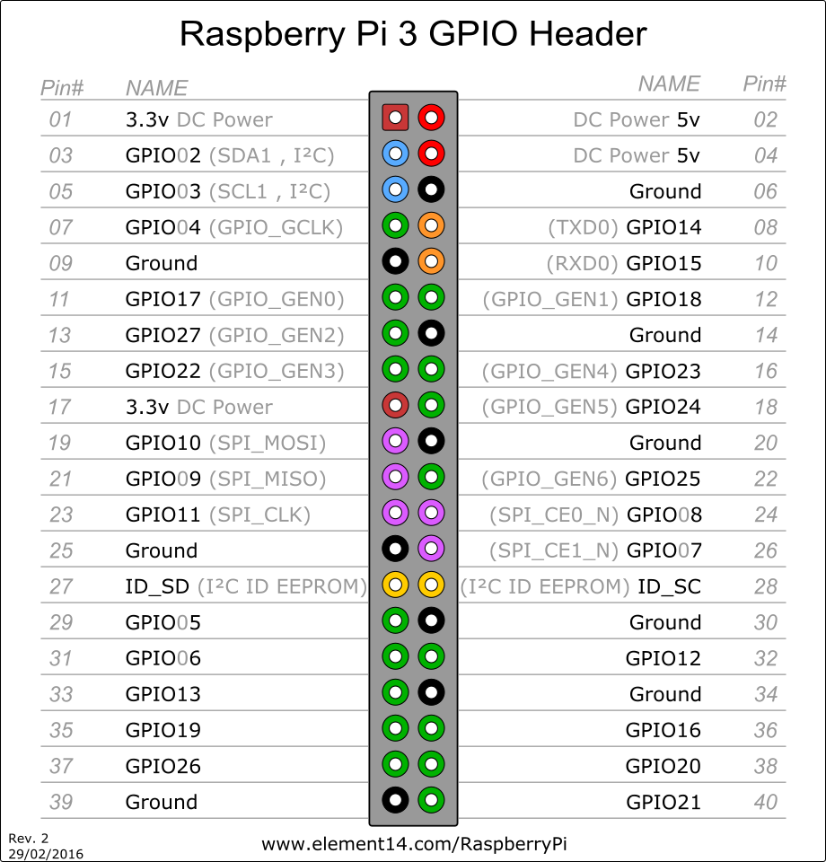

Raspberry Pi GPIO Pinout
24x - GPIO pins
2x - SPI bus
1x - I2C bus
2x - 5V power pins
2x - 3.3V power pins
8x - Ground pins

Slide 47
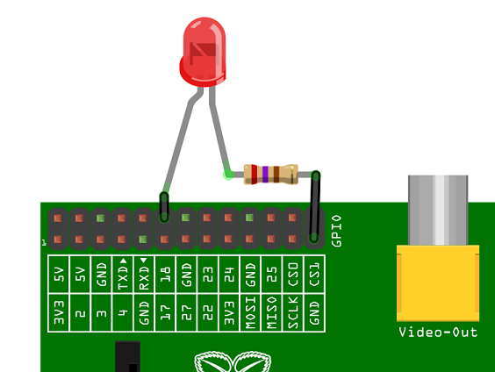
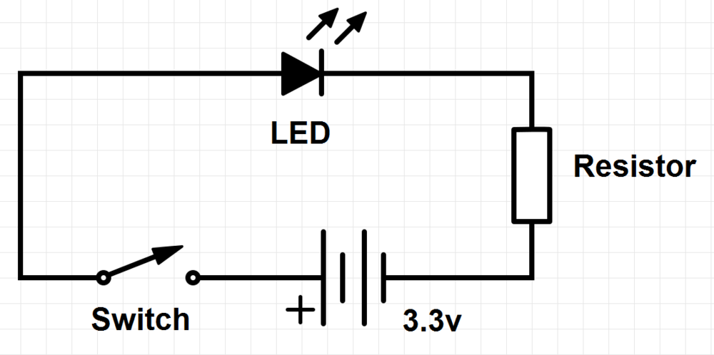
A Simple circuit design that uses the RasPi GPIO Pins.

Slide 48
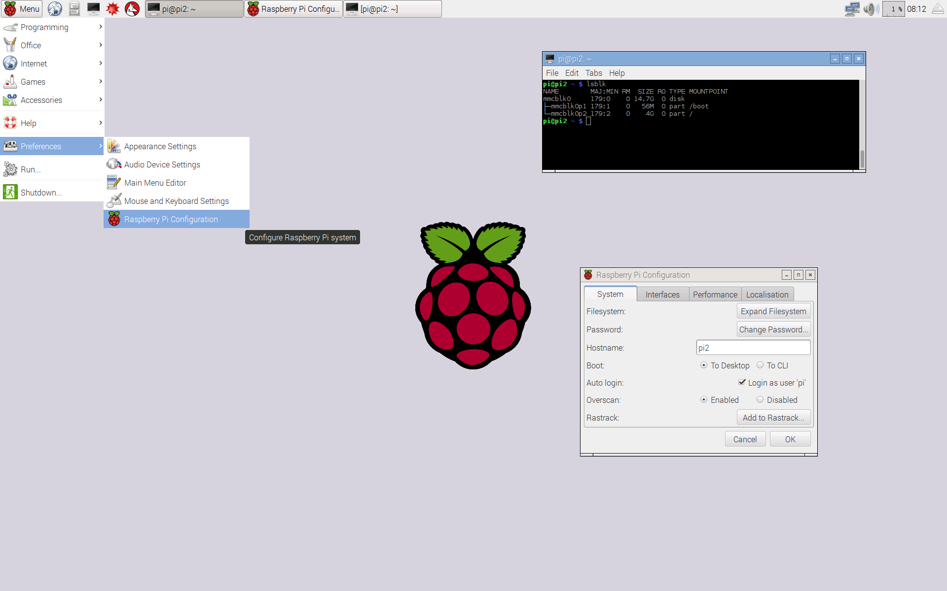
Raspbian Jessie
Raspbian is the supported operating system for Raspberry pi.
It is a free operation system based on Debian that is optimized for the Raspberry Pi hardware.
Verisons are named after the character of the “Toy Story” movie. The previous Raspbian version is named Wheezy.
It is still under active development.
Raspberry Pi foundation doesn’t make this OS. It is not their product.
It comes with pre-install software for education, programming, and general use such as text editor, Python, and Java more.
Its GUI is also very easy to use.

Slide 49
Good sources to learn more about Raspberry Pi.
MagPi Magazine
Raspberry Pi website and blog
Element 14 Forum
Hack a Day website
Adafruit website

Slide 50
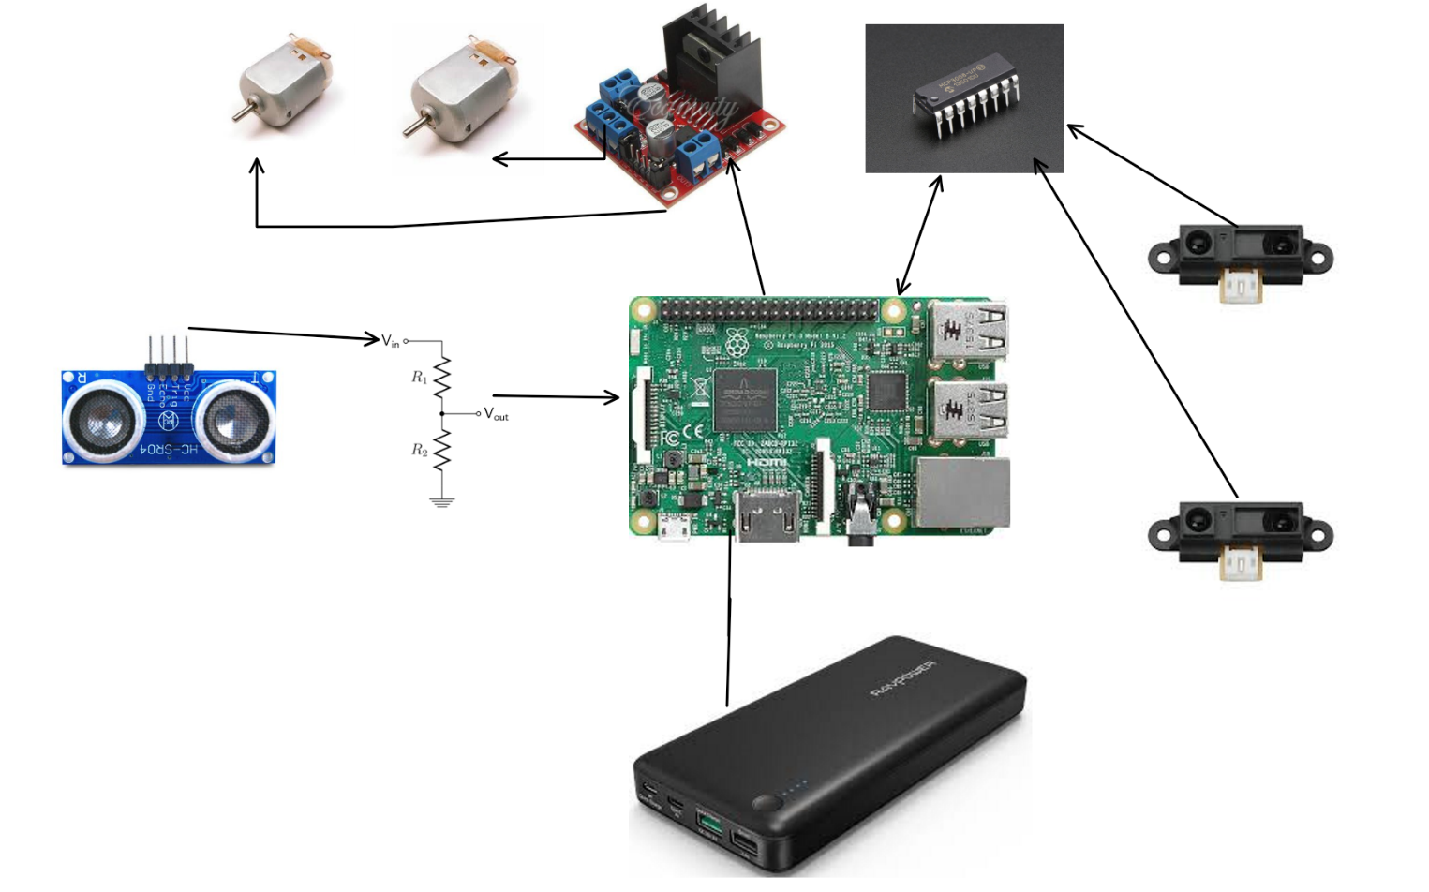
Vikingbot
You can find the top hardware design of the robot above. The robot consists of several different parts:
- 2 X DC motors
- 1 X Two channel DC motor driver
- 1 X ADC IC – MCP3000
- 2 X Sharp IR Distance Sensors – Sharp
- 1 X USB Battery Bank
- 1 X Ultrasonic Sensor
- 1 X 5 V to 3.3V voltage divider
- 1 X Raspberry Pi
- 2 X Micro USB Cables
- 20 X Jumper Wires
- 1 X bread board
- 1 X Plexiglass Robot Base
The Raspberry Pi reads the sensors and controls the speed and the rotation of the dc motors attached to the robot by running the Python scrips.

Slide 51
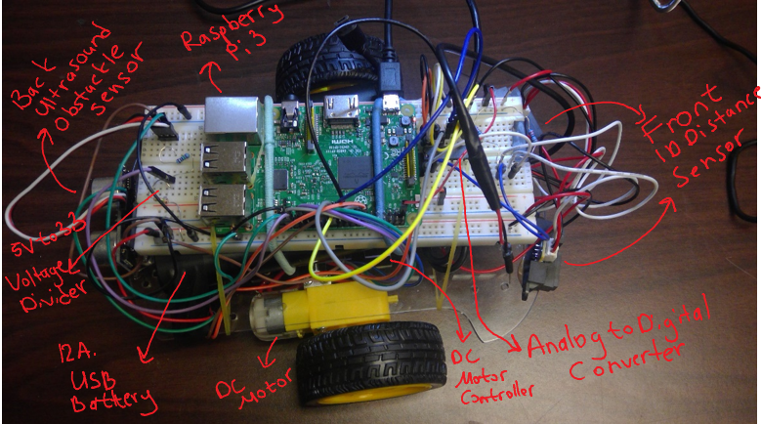

Vikingbot

Slide 52
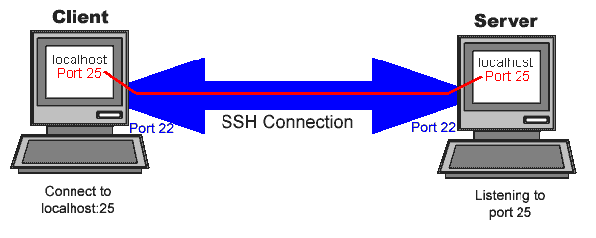
SSH
SSH, also known as Secure Socket Shell, is a network protocol that provides administrators with a secure way to access a remote computer.
In our case, we will use SSH connection to remote control our Raspberry Pi computers.

Slide 53
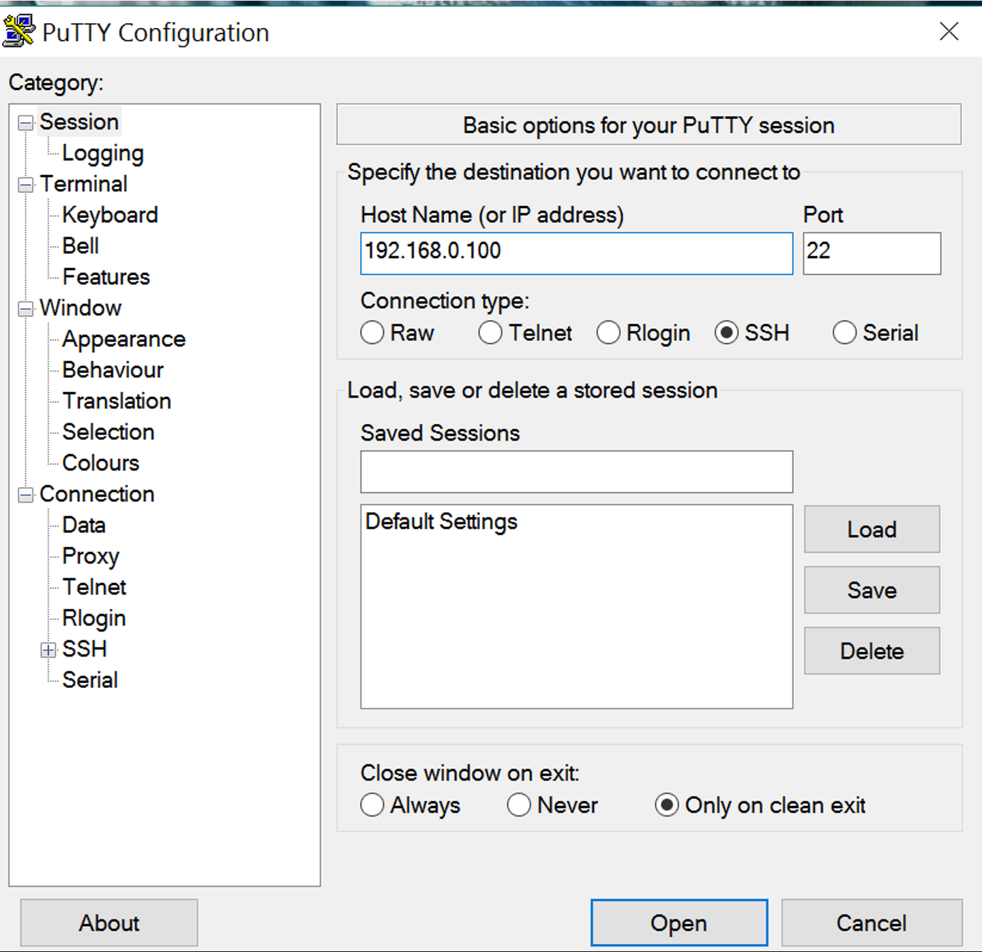
SSH - Windows
Type Raspberry Pi’s IP Address
Click on Open

Slide 54
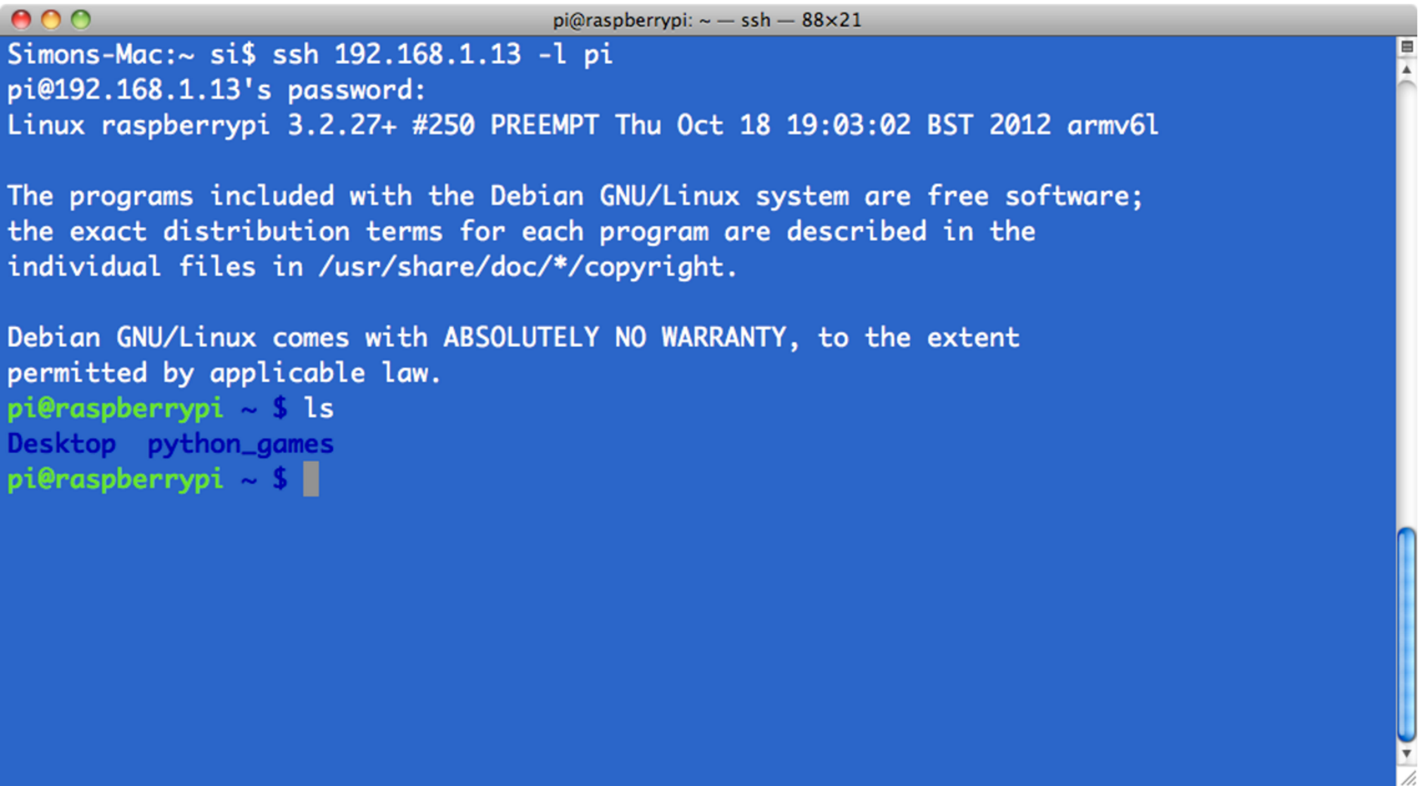
SSH – MAC OSX and Linux
ssh <ip address> -l pi
ssh 192.168.1.13 -l pi

Slide 55
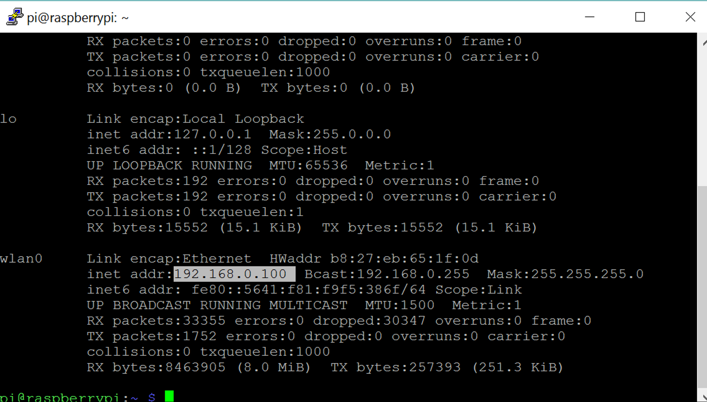
How to learn your IP address?

Slide 56
File Transfer
Windows
https://winscp.net/eng/index.php
Linux
scp sample1.txt sample2.txt your_username@remotehost.edu:
Mac
scp sample1.txt sample2.txt your_username@remotehost.edu:

Slide 57
Assignment 1
Login to your account on the server.
Create your Workspace on the server
Write a simple python code for Vikingbot
Go forward for 2 sec.
Turn left for 2 sec.
Go back for 2 sec.
Stop for 2 sec.
Turn right for 2 sec.
When there is an obstacle in front of the robot, the robot should stop, and then turn left
When there is an obstacle in the back, the robot should stop, and then turn right
Assume you have the following class name and methods:
Class name: Vikingbot
goForward()
goBack()
stop()
turnLeft()
turnRight()
changeSpeed(speed) – your speed can vary between 50 - 100
readSensors() - frontLeft, frontRight, back (returns a value between 0-100 for each sensor)
Deadline:
Monday before class
No late assignment submission.

Slide 58
Resources
Robotic System Lab – ROS Lectures ETH Zurich
ROS - wiki.ros.org
Mastering ROS for Robotics Programing - Lentin Joseph
A Gentle Introduction to ROS - Jason M. O'Kane
www.rapberrypi.org
www.adafruit.com
www.pdxrobotics.com

